Slide 1

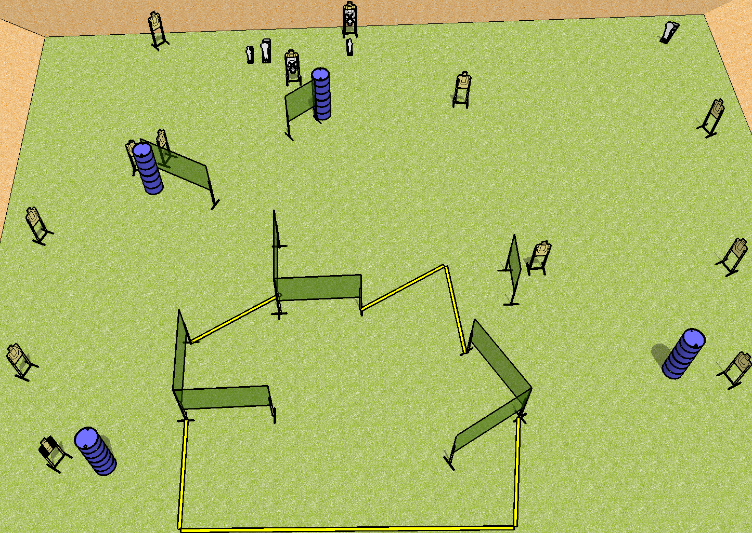
 | Dothan Practical Shooters – USPSA Match New Year Same Old Course Designer : Drew Coleman Bay: C2
Round Count 30 rounds 13 USPSA 2 minis, 2 colts
Equipment List 15 wall feet 14 targets (12 + 2 NS) 1 tux

Slide 2
New Year Same Old
Written Stage Briefing
Scoring: Comstock Rounds: 30
Targets: 13 USPSA, 4 steel
Handgun start position: anywhere inside the shooting area, wrists below belt. Handgun is loaded and holstered.
PCC start position: anywhere inside the shooting area, stock on belt. Loaded PCC is held with both hands, safety on.
Stage Procedure: on the audible start signal, engage targets as they become available from within the shooting area.

